Slide 1
Makeathon 2023
Idea Submission

Slide 2
TEAM NAME : SakhiCode
MEMBER DETAILS :
Member 1 : Jigyasa Gupta Member 2 : Shiwanshi Jha Member 3 : Ankita Nigam
THEME:
Rewards gamification for credit or debit card transaction

Slide 3
PROBLEM STATEMENT
Many credit and debit card users are missing out on the benefits and rewards offered by their financial institutions due to low engagement with the existing reward programs. This results in missed opportunities for both cardholders and financial institutions. To address this issue, we aim to develop a gamified mobile application, AmexGo that effectively incentivizes and engages users to actively take advantage of reward programs offered by banks and financial institutions. The app will incorporate challenges, daily games, monthly analysis of spend and rewards, category-wise challenges, and an interactive map to guide users to nearby stores to collect rewards. It will also feature RewardBuddy, which analyzes spending habits and provides personalized recommendations to maximize rewards. The app will also include social sharing and a leaderboard to encourage healthy spending habits, engagement and peer-learning.

Slide 4
SOLUTION + IMPACT
An app based gamified solution to unleash the potential of rewards to the users with the following features :
Challenges : For engaging + informative games unveiling rewards
Daily challenges : Bingo/Jumbled Words/Spin the wheel/ Memory Game (Reward vs action_to_claim cards) /Trivia quiz game/Archery/Ring a Reward : Win and learn how to claim rewards through user-friendly mini games.
Monthly Wrapped : Navigate through monthly spend + rewards earned analysis
Category wise challenges :
Fitness challenge(Step count to earn fitness vouchers)
Food challenges(Score in Candy crush like game)
Shopping challenges(Grab most deals on e-commerce sites)
AmexGo(Mall of Rewards) : Mapping user’s location, it mirrors real-world shops to a virtual game and directs them to nearby stores to collect rewards(in-store/on 3rd party apps).
Has hint-based navigation to accomplish task(sign-in for alerts, refer a friend, set up a wallet) or spot the treasure(reward) while tackling challenges like decision-making, EMI payment,alerts on suspicious login,etc.
Facilitates understanding and highlights the significance & breadth of rewards program with exciting graphics for thrill, putting user’s thinking caps on, building healthy spending habits and accruing maximum rewards for each transaction.
RewardBuddy : Analyzes spending habits(ML Model) to help with decision making using a Personalized Recommendation System (highlighted during games & on transactions) to maximize deals catering to wider user segments and market.
Social Sharing : Leverage the social networks of friends to share their Monthly Wrapped/Badges/rewards/position on leaderboards to Social media platforms( Twitter, Instagram, etc. even in game) & get likes, shares and give peer-referrals to maximize engagement in their peer circle and be appreciated for healthy spending habits which also promotes peer-learning.
Leaderboard : Appreciate top-players for overall spends, rewards collection, good CIBIL Score, referrals, social sharing,etc.

Slide 5
SOLUTION
Frameworks/Technologies stack :
React Native Game Engine & Matter.js : Game development
React Native & TypeScript : Frontend and backend
TensorFlow & PyTorch, Python for Machine Learning & analysis : Personalized Recommendations
Firebase / Amazon Web Services : Data storage and serverless scalability
Expo : Testing app
Assumptions & constraints : Users have a smartphone with internet connection and are ready to share data for personalized recommendations. Marketing the game to targeted user through mails and social media would be necessary to build initial leaderboard.
Solution decision points : React Native can be used to develop both Android and iOS apps . Research shows the effectiveness of gamification in motivating behavior change which is achieved in-app using React Native Game Engine. The use of personalized recommendations to provide users with a tailored experience to maximize the rewards can be achieved by analyzing data and training the ML model for large scale recommendations.
Implementation & Effectiveness : Development of a mobile app integrating rewards program backend to track user spending and reward accrual linked to the leaderboard. The gamification elements would lead to user adoption and enable them to see value of the rewards and tweak spending habits to leverage the rewards program and learn from peers and share on social media for appreciative thrill, which could lead to increased revenue for the company.
Extent of Scalability :
Suited to all segments of users with varied interest and spending habits using tailored gamified experiences.
The app can leverage cloud-based infrastructure to handle increased user traffic & accommodate fluctuating demand per second
Performance Monitoring and Optimization to improve overall system efficiency.

Slide 6
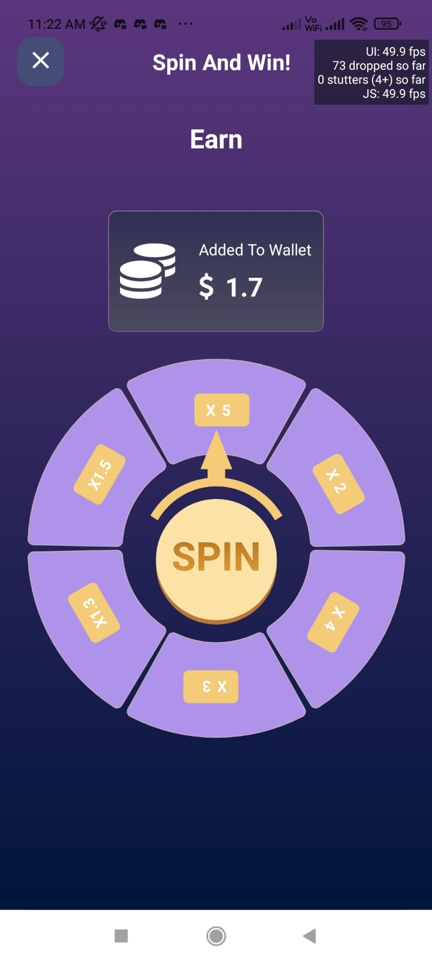

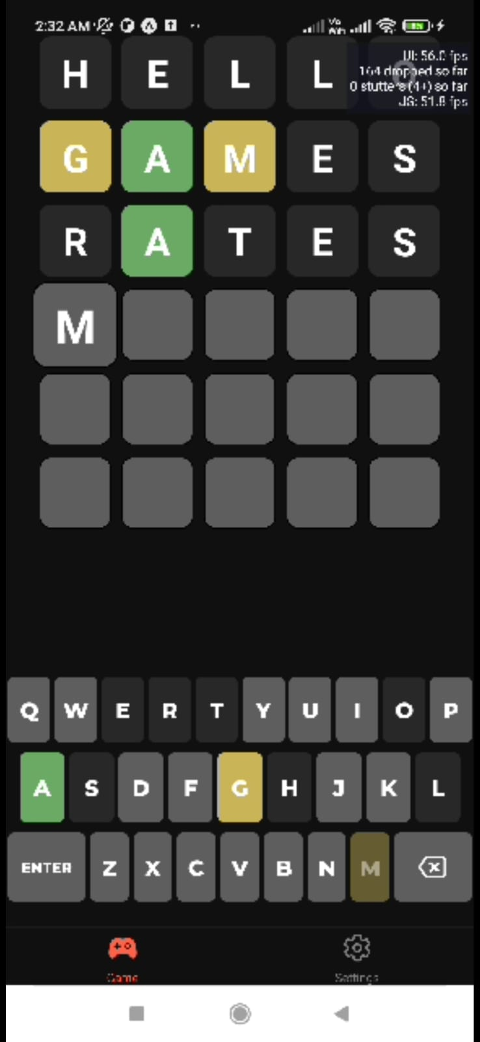
SCREENSHOTS: Daily Challenges

Slide 7
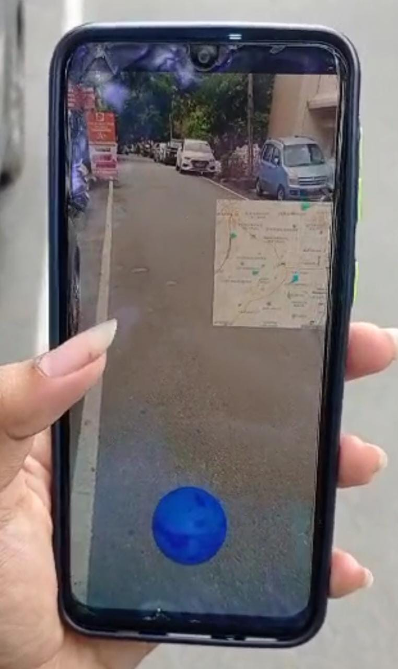
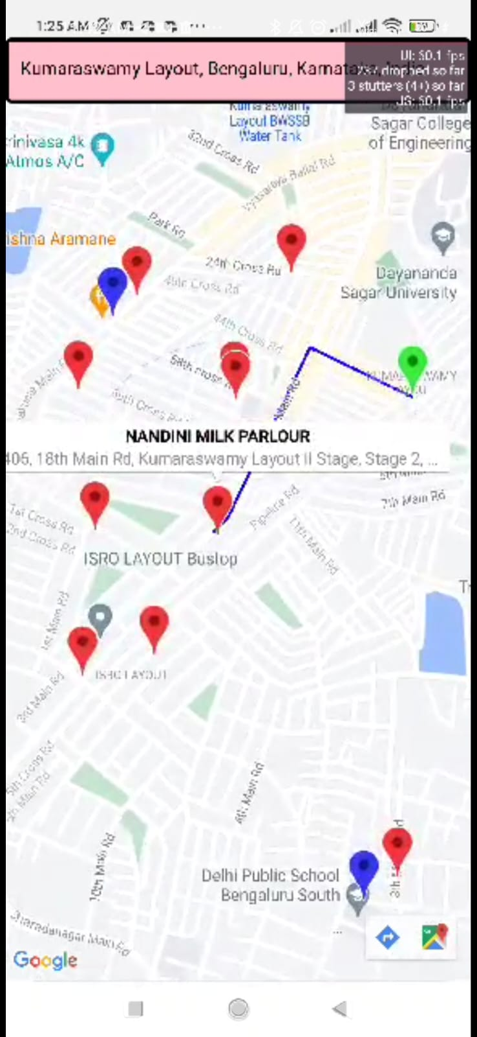
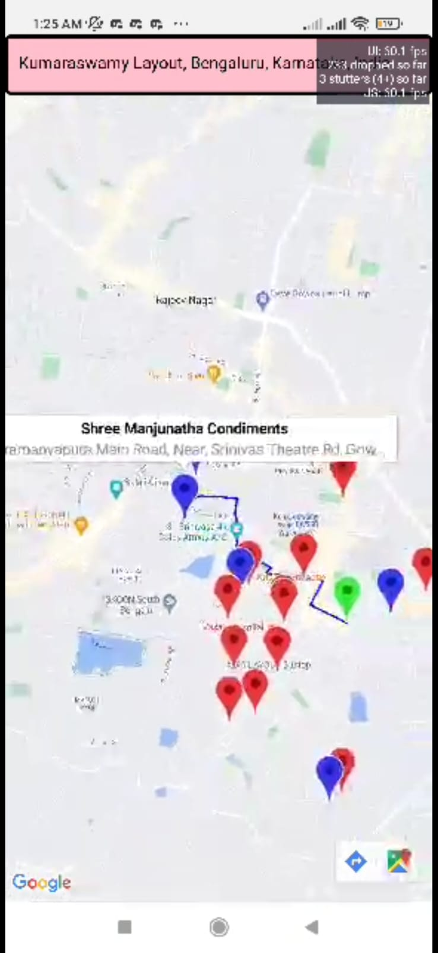
SCREENSHOTS:
AR Game
Shop Local

Slide 8
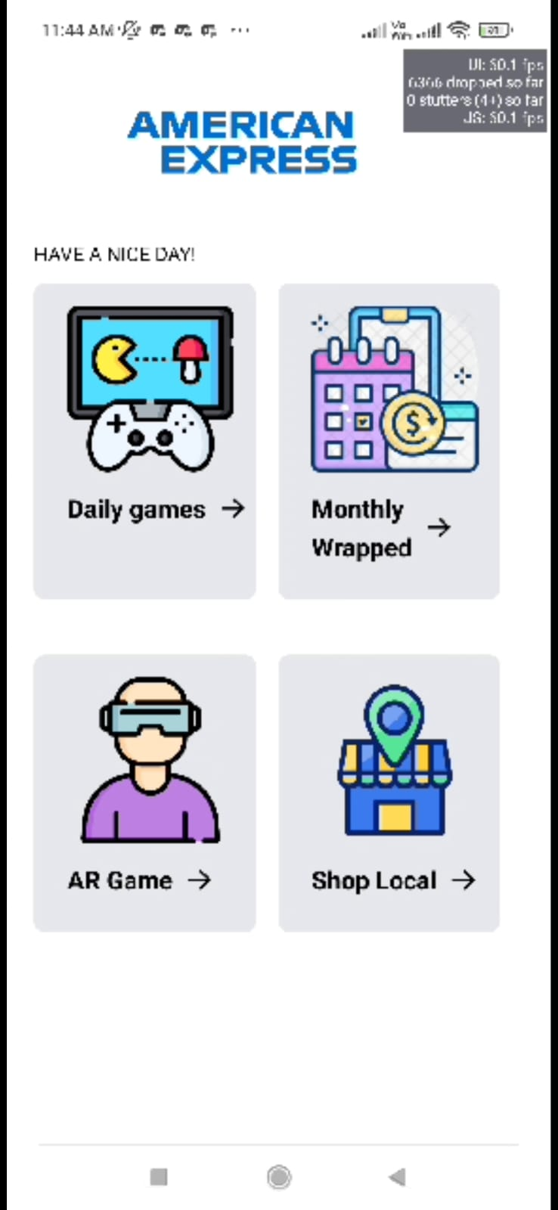
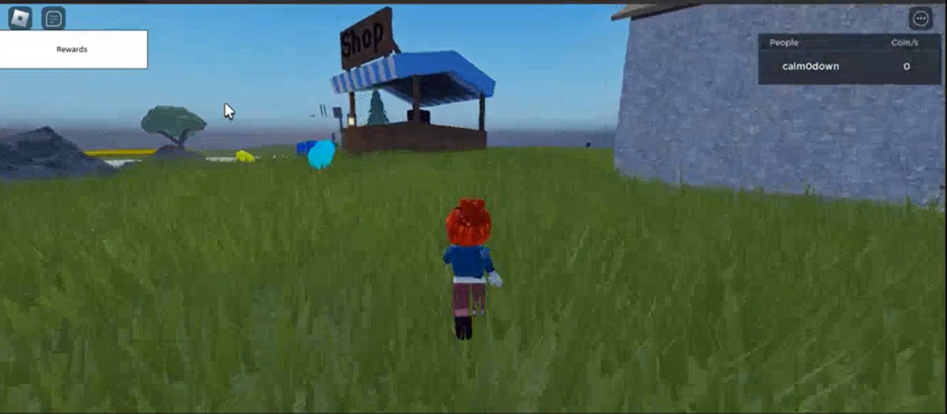
SCREENSHOTS
App Interface
Roblox Game

Slide 9
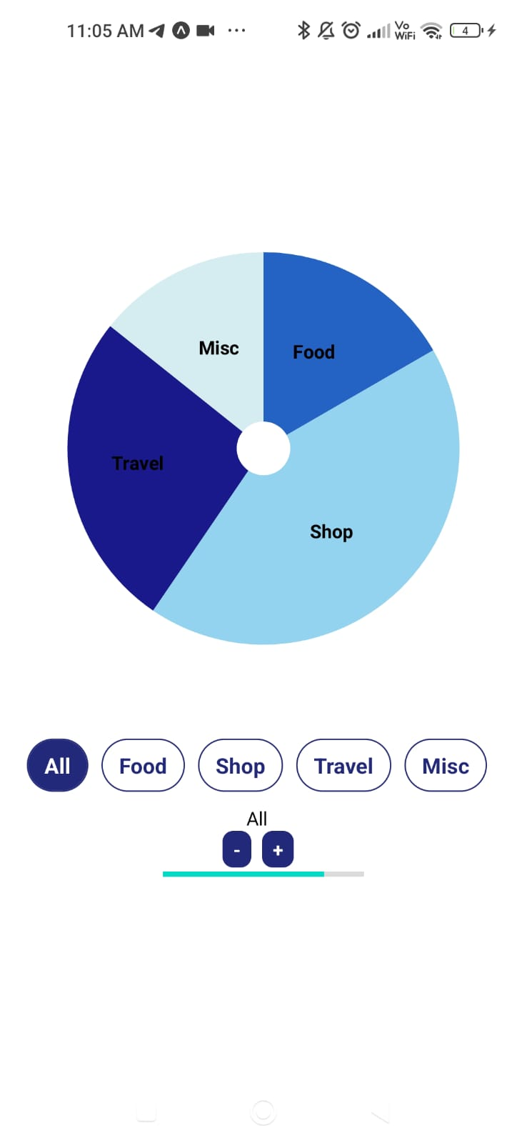
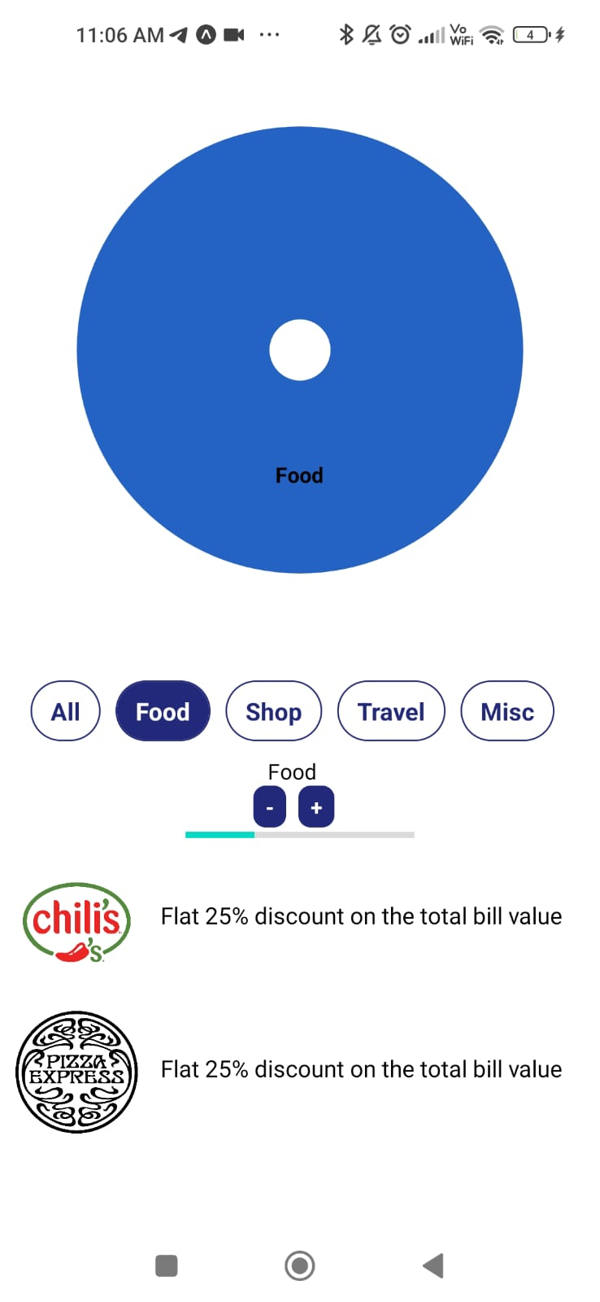
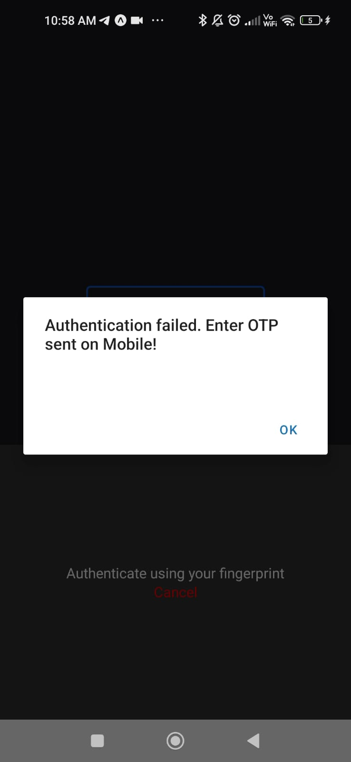
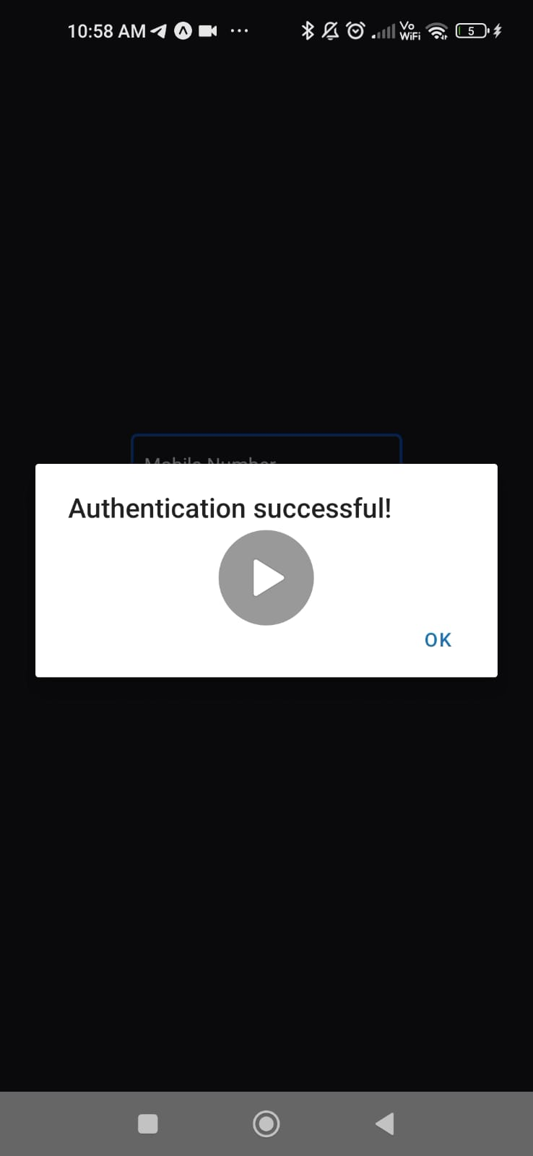
SCREENSHOTS
Monthly Wrapped
Security Alerts via FingerPrint

Slide 10
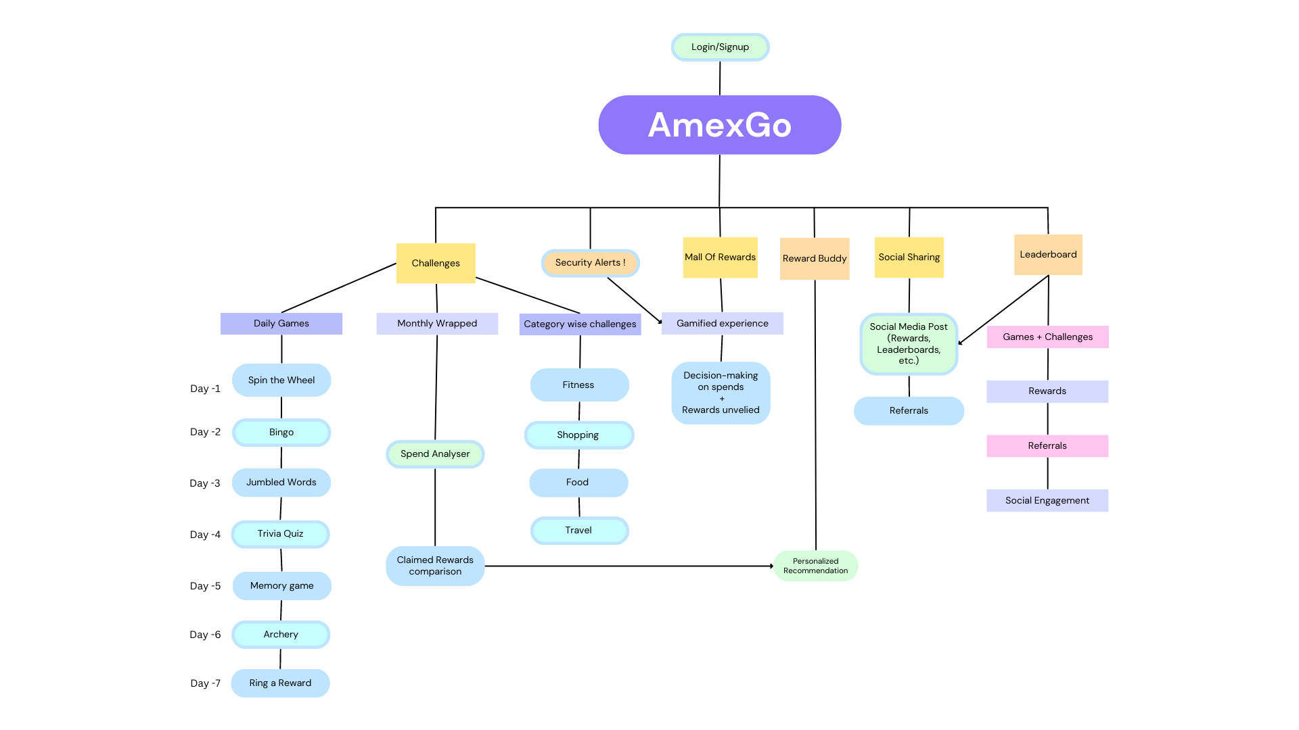
FLOWCHART : Link

Slide 11
SOCIETAL IMPACT/ NOVELTY
FUTURE SCOPE
→ Business Relevance :
1. Better spends to gain maximum rewards.
2. Increased user engagement for thrill of gamification
3. More discoverability of rewards
4. Wider segments of companies to collaborate with.
5. Better customer relationships : valued & rewarded for loyalty
→ Optimization :
1. Continually evaluate engagement based on categories of rewards.
2. Adjust game elements, frequency & type of challenges.
3. Better accuracy of Machine Learning model for recommendations
→ Scope for Modification :
1. Scaling to multi-player games
2. Customized rewards for user segments(fitness, shopping,etc.).
3. In-app social media elements for sharing.
4. Chat forums, friend requests to share rewards, spend habits and progress.
Financial Literacy - personal finance & rewards.
Peer learning promoted
Informed decision making & planning using spend analyzer.
Responsible spending, healthy habits(step count for rewards) and significant savings.
Social engagement & community building – sharing achievements, rewards, and financial milestones with their social networks.
Financial well being – individual & community – can even educate people uninterested in financial planning.
Thrill to top leaderboards leads to financial maturity

Slide 12
THANK YOU
link

